Slide 1
Adventure Works Cycles
Group 4
Team Members
1) Santanu
2) Varsha
3) Madhumita
4) Nishikant
5) Mohasin
6) Faiz

Slide 2
About company
Adventure Works Cycles, the company on which the Adventure Works sample databases are based, is a large, multinational manufacturing company. The company manufactures and sells metal and composite bicycles to North American, European and Asian commercial markets. While its base operation is in Bothell, Washington with 290 employees, several regional sales teams are located throughout their market base.
n 2000s, Adventure Works Cycles bought a small manufacturing plant in Mexico. Which manufactures several critical subcomponents for the Adventure Works Cycles product line. These subcomponents are shipped to the Bothell location for final product assembly. In 2001, this manufacturing plant became the sole manufacturer and distributor of the touring bicycle product group.
Coming off a successful fiscal year, Adventure Works Cycles is looking to broaden its market share by targeting their sales to their best customers, extending their product availability through an external Web site, and reducing their cost of sales through lower production costs.I

Slide 3
OBJECTIVE
This Adventure works cycle company is Multinational company which manufactures and sells metals to North America, European & Commercial markets. So, we create KPI’s, Dashboards to visualize the sales of company which is compatible for customers and so the company can expand their business
The objective of the project is to analyze given Sales data and determine various KPIs (Key Performance Indicator) and to perform its visualizations.
Preparing the data and building visualizations
Technologies Used :
Microsoft Excel : Data cleaning, Pivot Table, use various functions like Vlookup, Filters.
Tableau & Power BI: Perform visualizations to showcase the KPI’s in the form of Dashboard.
SQL: Perform queries with syntax like Joins, Primary key, Alter table etc.

Slide 4
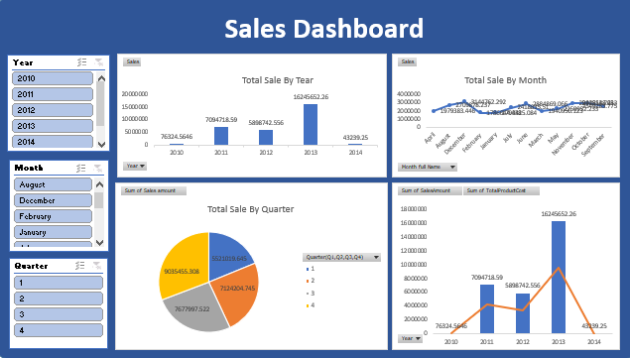
EXCEL DASHBOARD

Slide 5
Sql Queries & output
List the Names and salary of the employee whose salary is greater than 1000
select ENAME,SAL from emp where SAL >1000;
List the details of the employees who have joined before end of September 81.
SELECT *FROM emp WHERE HIREDATE<('1981-10-31');
List Employee Names having I as second character.
SELECT *FROM emp WHERE ENAME LIKE '_I%';--
List Employee Name, Salary, Allowances (40% of Sal), P.F. (10 % of Sal) and Net Salary. Also assign the alias name for the columns
SELECT ENAME, SAL, SAL*.10 PF , SAL*.40 Allowances, SAL-sal*0.10-sal*0.4 Net_Salary FROM emp; --
List Employee Names with designations who does not report to anybody
SELECT e.ENAME, e.JOB, e.MGR FROM emp eWHERE MGR IS NULL;--
List Empno, Ename and Salary in the ascending order of salary.
select EMPNO, ENAME, SAL FROM emporder by SAL;--
How many jobs are available in the Organization ?
select count(distinct job) from emp;--
Determine total payable salary of salesman category
SELECT JOB, sum(SAL)FROM emp GROUP BY job having job = "salesman";

Slide 6
Write a query to match the salespeople to the customers according to the city they are living.
select s.sname Salesman, c.cname Customer_Name, c.city
from salespeople s, Cust c
where s.city=c.city;
Write a query that lists each order number followed by name of customer who made that order.
select o.onum, c.cname
from orders o, cust c
where o.cnum=c.cnum;
Write a Query to find all orders credited to the same salesperson who services Customer 2008.
SELECT * FROM orders WHERE snum =
(SELECT DISTINCT snum
FROM orders
WHERE cnum =2008);
Write a Query to find all orders attributed to salespeople in London.
select * from orders
where cnum in(select cnum
from cust
where city='London');
Write a query to show each salesperson with multiple customers.
select a.snum,b.sname,count(*) as cust_count from cust a, salespeople b where a.snum=b.snum group by a.snum;

Slide 7
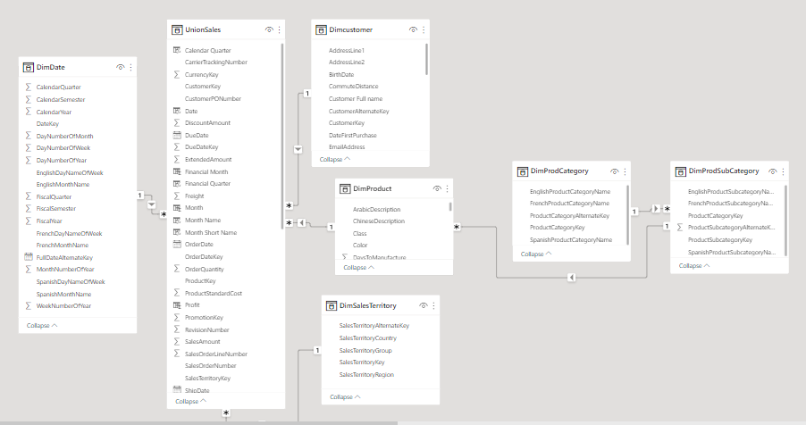
Data modelling in power bi

Slide 8
dax
Year = UnionSales[Date].[Year]
Month = UnionSales[Date].[MonthNo]
Month Name = UnionSales[Date].[Month]
Month Short Name = FORMAT(UnionSales[Date],"mmm")
Calendar Quarter = UnionSales[Date].[Quarter]
Weekday No = WEEKNUM(UnionSales[Date],2)
Weekday Name = WEEKDAY(UnionSales[Date
Weekend or Weekday = IF(WEEKDAY(UnionSales[Date],2)>=6,"weekend","weekday")
Financial Month = MONTH(EDATE(UnionSales[Date],-3))
Financial Quarter = "Qtr " &
CEILING(MONTH(EDATE(UnionSales[Date],-3)),3)/3
Year Month = FORMAT(UnionSales[Date],"mmm-yyyy")

Slide 9
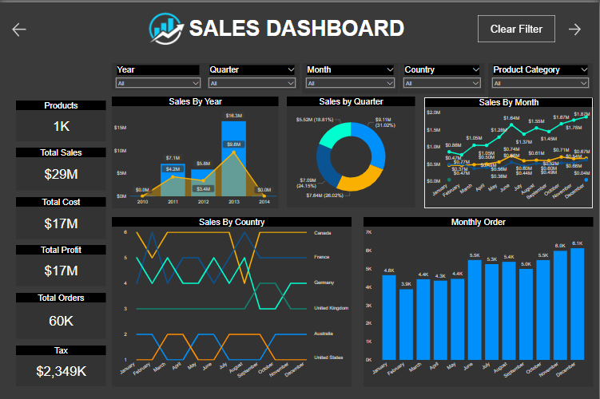
Sales DASHBOARD (power bi)

Slide 10
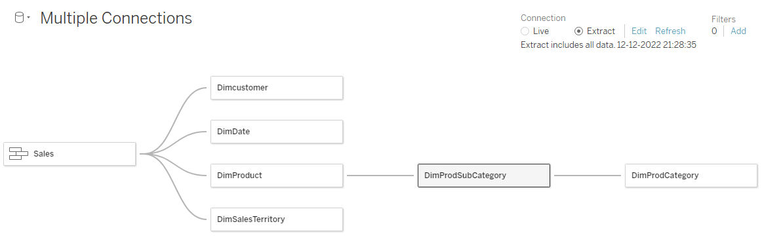
Data modelling (Tableau)

Slide 11
Calculated Fields
Date = DATE(DATEPARSE ( "yyyy", STR(YEAR([Full Date Alternate Key])) ))
Weekend or Weekday = IF DATEPART('weekday',[Full Date Alternate Key]) = 7 or
DATEPART('weekday',[Full Date Alternate Key]) = 6
THEN "Weekend"
ELSE "Weekday"
END
Weekday Name = DATENAME('weekday',[Full Date Alternate Key])
Financial Quarter = DATEPART('quarter',DATEADD('month',-3,[Full Date Alternate Key]))

Slide 12
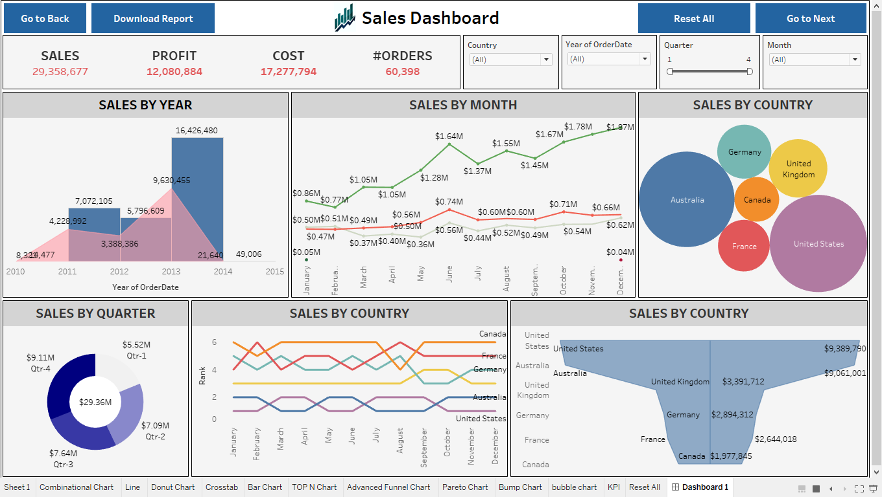
Sales DASHBOARD (Tableau)

Slide 13
Thank You

